Slide 1


VLSI testing
Introduction
HEP
Notes:
The semiconductor industry, driven by ever-increasing demands for higher performance and reliability, as well as greater functionality and speeds, continuously introduces new higher density technologies and new integrated circuits. These circuits, like any other complex systems, not only have to meet the performance and functionality requirements, but they also have to be manufacturable. In particular, they have to be highly testable in order to meet extremely demanding and constantly growing quality requirements. With the cost of testing becoming a significant part of the cost of new microelectronics products, with inevitably upcoming challenges of new deep submicron technologies, with the increasing role of the hardware-software co-design, and with ever-changing customer expectations, a demand for new test solutions and tools appears to be relentless. This course provides a coverage of the most essential digital circuit testing techniques, including practices and automation methods for high-quality low-cost manufacturing test. In addition to fault modeling, test generation and fault simulation, it covers design for testability, built-in self-test for random logic and memory arrays altogether with the newest topics related to embedded test methodologies developed specifically to reduce test data volume, test time, and yield learning. The lectures are intended for senior undergraduate and graduate students of computer science, computer engineering, electronics and telecommunications, as well as robotics and control.
This presentation is partially based on the results of our research projects, some of which have been presented in IEEE publications. It is our pleasure to acknowledge the support we received from Mentor Graphics Corporation at various stages of this project within the framework of the Higher Education Program. Our special thanks go Ian Burgess and Janusz Rajski for their initiative and encouragement. Ron Press and Martin Keim provided us with many valuable comments and suggestions. Last but not least, we would like to express our gratitude to Grzegorz Mrugalski of Mentor Graphics Polska for his assistance in preparing many materials presented throughout this course.

Slide 2

References – books
M. Abramovici, M.A. Breuer, A.D. Friedman, Digital Systems Testing and Testable Design, IEEE Press, 1990
P.H. Bardell, W.H. Mcanney, J. Savir Built-In Test for VLSI: Pseudorandom Techniques, John Wiley & Sons, 1987
M.L. Bushnell, V.D. Agrawal, Essentials of Electronic Testing for Digital, Memory and Mixed-Signal VLSI Circuits, Kluwer Academic Publishers, 2000
A.L. Crouch, Design-for-Test for Digital IC’s and Embedded Core Systems, Prentice Hall, 1999
R. Dean Adams, High Performance Memory Testing, Design Principles, Fault Modeling and Self-Test, Kluwer Academic Publishers, 2003
P. Girard, N. Nicolici, X. Wen (ed.), Power-Aware Testing and Test Strategies for Low Power Devices, Springer, 2010
D. Gizopoulos (ed.), Advances in Electronic Testing, Springer, 2006
A. van der Goor, Testing Semiconductor Memories: Theory and Practice, John Wiley and Sons, 1991
Notes:
Several examples, procedures, discussions, and illustrations used on the slides to follow were inspired by ideas presented originally in one the above referenced books. We strongly encourage users of this course to refer to these books, especially with respect to aspects of VLSI test that have not been presented here because of space limits or other constraints. Please note that additional reference items are mentioned throughout this course wherever appropriate. They are indicated by a small book icon similar to that on this slide.

Slide 3
References – books
N. Jha, S. Gupta, Testing of Digital Systems, Cambridge University Press, 2003
B. Nadeau-Dostie, Design for At-Speed Test, Diagnosis and Measurement, Kluwer Academic Publishers, 2000
S. Pilarski, T. Kameda, A Probabilistic Analysis of Test-Response Compaction, IEEE Computer Society Press, 1995
J. Rajski, J. Tyszer, Arithmetic Built-In Self Test for Embedded Systems, Prentice Hall, 1998
C. Stroud, A Designer’s Guide to Built-In Self-Test, Kluwer Academic Publishers, 2002
L.-T. Wang, C. Stroud, N.A. Touba (ed.), System on Chip Test Architectures, Elsevier, Morgan Kaufmann Publishers, 2008
L.-T. Wang, C.-W. Wu, X. Wu (ed.), VLSI Test Principles and Architectures, Elsevier, 2006
Notes:
The list of test related books and textbooks continues on this slide.

Slide 4
References – journals & proceedings
IEEE Transactions on CAD of Integrated Circuits and Systems
IEEE Design and Test of Computers Magazine
IEEE Transactions on Computers
IEEE Transactions on VLSI Systems
Journal of Electronic Testing (JETTA)
IEEE International Test Conference (ITC)
IEEE VLSI Test Symposium (VTS)
IEEE European Test Symposium (ETS)
IEEE Asian Test Symposium (ATS)
Design Automation Conference (DAC)
Design and Test in Europe Conference (DATE)
Notes:
Many interesting detailed solutions can be found in the papers published over the years in journals, magazines and proceedings of test-related conferences. The most crucial archival publications as well as the key test events are listed on this slide. In both cases, the vast majority of papers are readily available on the IEEExplore web site - ieeexplore.ieee.org.

Slide 5
References – miscellaneous
Commercial EDA reference manuals and web pages
ASIC vendors reference manuals and web pages
Patent descriptions and US Patent and Trademark Office web site
Notes:
More information can be found on web sites maintained by EDA companies or ASIC vendors. A very good place to start with is also the US Patent and Trademark Office. It is worth noting that some test-related solutions were never published in the open technical literature, and their only descriptions are available in a form of patent documents.

Slide 6
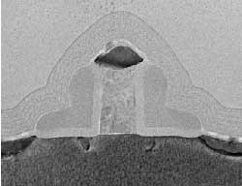
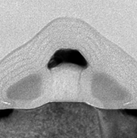
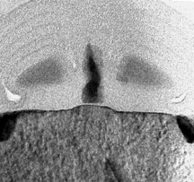
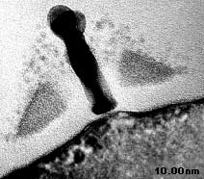
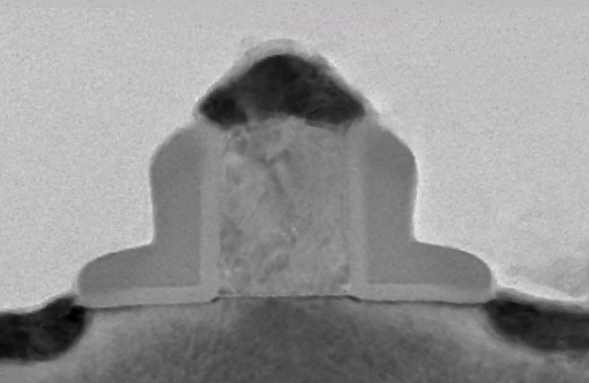
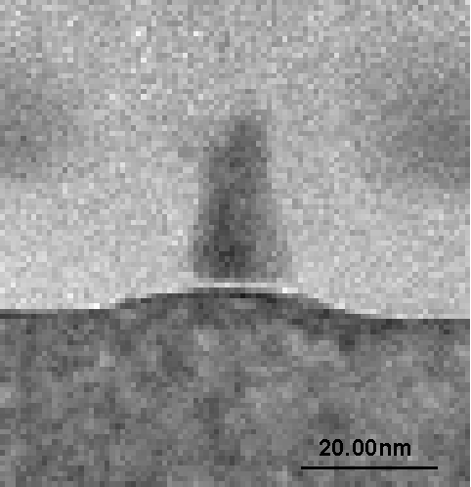
Technology trends
Intel transistor technology evolution
Moore’s law – transistors double every 18 months
Geometries shrink 10.5% per year
Overall chip sizes increase 12% per year
58% more devices produced per year
Defect sizes do not shrink in proportion
Increase of wiring levels
Interconnect delays dominate (gate delays reduced)
Advent of 3-D designs
Notes:
Did you read a paper “Cramming more components onto integrated circuits” published in 1965 in Electronics, vol. 38, no. 8? Its author, Gordon E. Moore, director of Research and Development Laboratories at Fairchild Semiconductor at that time, was prophetically predicting that “with unit cost falling as the number of components per circuit rises, by 1975 economics may dictate squeezing as many as 65,000 components on a single silicon chip”. Earlier he had a presentation at the International Solid-State Circuits Conference where he said: “No exponential is forever but we can delay *forever*”. Thanks to Intel we can now show transistors that more or less correspond to the technology nodes. The smallest and fastest transistor has a gate length of 10 nm and switching time under 0.5 ps. As geometries shrink they affect both transistors and interconnects. The transistor scaling rules say that when you make a transistor smaller you have to reduce the voltage and oxide thickness for optimum performance. Smaller voltage introduces more susceptibility to noise, signal integrity problems and IR drop. Smaller voltage also increases a sub-threshold leakage. Thinner oxide increases gate leakage. These technology trends clearly impact current VLSI test practices as we will see soon.
At another occasion, G. Moore said: “If the auto industry advanced as rapidly as the semiconductor industry, a Rolls Royce would get a half a million miles per gallon, and it would be cheaper to throw it away than to park it”.

Slide 7
System-on-Chip characteristics
System architecture
microprocessors, DSP cores
buses, peripherals, memory
ASIC portion
Structures: logic, memory, analog
Multiple embedded memories: SRAM, DRAM, Flash
Analog and mixed signal: PLLs, clock recovery
Field programmable logic
RF cores: wireless receivers
IP cores available from multiple vendors
Notes:
The electronics industry aggressively shrinking chip features below 50 nanometers and moving toward three-dimensional (3D) integrated circuits has made a dramatic impact on design and test. For example, contemporary system-on-chip (SoC) and system-in-package (SiP) designs embed more than billion transistors running at operating frequencies in the gigahertz range. These designs can include variety of digital, analog, mixed-signal, memory, optical, micro-electro-mechanical and radiofrequency cores (or modules). Testing designs of such complexity is a significant and serious challenge. The popularity of SoC circuits has led to an unprecedented increase in the cost of test. This rise is primarily attributed to the difficulty in accessing embedded cores during test, long test development and test application times, and large volumes of test data. Although network-on-chip (NoC) systems can alleviate some of the core communication problems, these structures in turn have further complicated the SoC test procedures.

Slide 8
Growing complexity - ITRS
Year | 2001 | 2004 | 2007 | 2010 | 2013 | 2016
Node [nm] | 130 | 90 | 65 | 45 | 32 | 22
Devices [million tr.] | 276 | 553 | 1106 | 2212 | 4424 | 8848
Voltage [V] | 1.2 | 1.0 | 0.7 | 0.6 | 0.5 | 0.4
Oxide thickness [nm] | 2.3 | 2.0 | 1.4 | 1.2 | 1.0 | 0.9
Static power per dev | 1.00 | 1.96 | 9.46 | 17.32 | 25.00 | 19.64
Intel Broadwell i7 CPU(2015): 14nm, 1.4x10⁹ transistors, 15W
server: 2x10⁹ transistors, 28W, die size 133 mm²
fully SoC design
International Technology Roadmap for Semiconductors, 2011
Notes:
The International Technology Roadmap for Semiconductors, known throughout the world as the ITRS, is the fifteen-year assessment of the semiconductor industry’s future technology requirements. These future needs drive present-day strategies for world-wide research and development among manufacturers’ research facilities, universities, and national labs. ITRS provides downloadable files that contain the most recent information from the International Technology Working Groups. Typically, a working document is a collection of updated tables and figures from the previous years and are based on the latest information from the industry. One of the key questions addressed by the ITRS reports is: how is the semiconductor roadmap going to impact test? What challenges can we expect? Clearly, it makes sense to focus on new emerging problems for which there are no solution. And solutions and tools that will no longer be adequate.

Slide 9
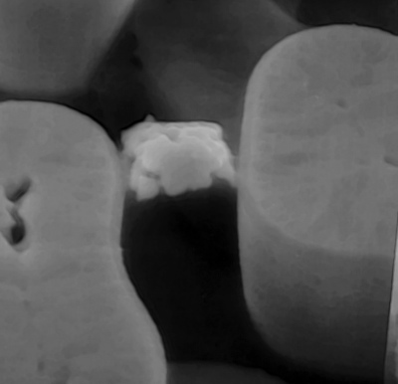
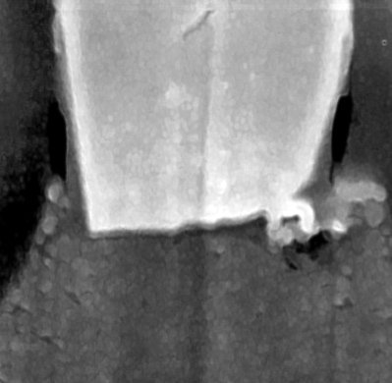
Nanometer designs – test challenges
Growing gate counts
exploding test data volume
unacceptable test times
Complex SoC architectures
multiple test methods required
embedded memory everywhere
Small geometries + new materials = new defects
resistive bridging & vias
traditional testing is not enough
many small delays
Complex interconnects
100 million gates, 400 million transistors
billions of vias
6 km of wire / cm²
Resistive short
Resistive via
P. Nigh, IEEE ITC 2001
Notes:
The first integrated circuit was built in 1961. Since then many standard techniques have been invented that served testing well over the years. Apparently, things tend to accelerate recently. Many of them are severely challenged by nanometer technology designs. The world of classical photography has Ansel Adams and beautiful pictures of Yosemite National Park. VLSI test has many practitioners that use much more expensive cameras to take beautiful pictures of ugly defects. The two most representative examples of defects that expose loopholes in conventional test are bridging defects and resistive opens. None of them is guaranteed to be detected by conventional tests. Both types of defects are on the rise. None of them changes the logic function and none increases the current. They affect the circuit by introducing a very small delay. In one case it is a conditional delay. In both cases it could be so small that it may not be detected even if it propagates to the output. These defects are very pattern sensitive.
Transistor scaling rules require that with the reduced gate length both the voltage and gate oxide are reduced. That in turn increases leakage. Static power is expected to grow exponentially. A bridging defect with the same resistance will draw more or less the same current but the background current will be increasing. It will become increasingly more difficult to distinguish between good and faulty behavior. Hence, there are two issues:
there is an abundance of new types of detects that conventional tests do not detect, i.e., in-line-resistance,
for other faults like resistive bridges, it becomes more difficult to distinguish between good and faulty behavior.

Slide 10
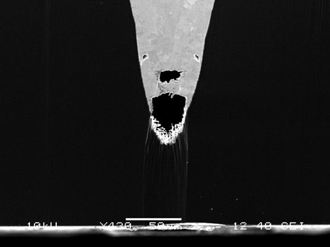
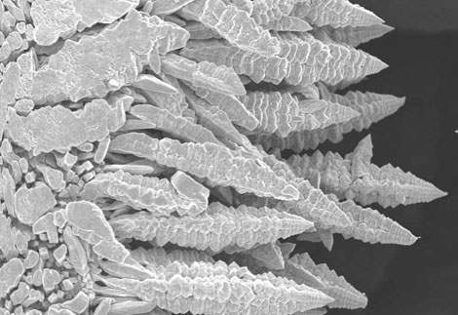
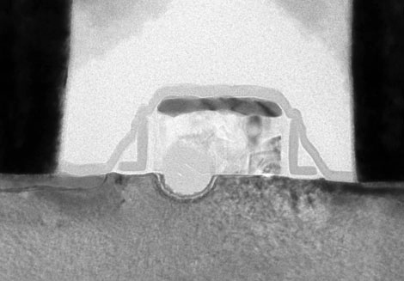
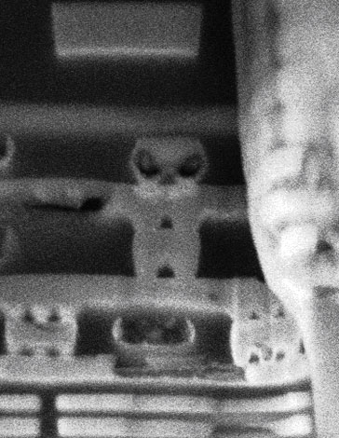
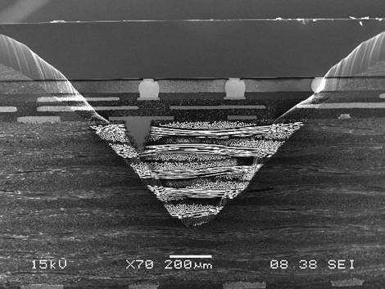
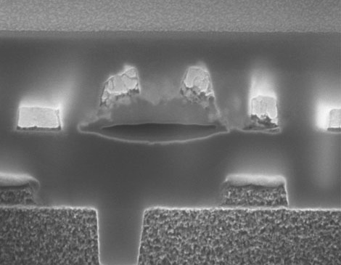
Failures photo gallery
(1)
(3)
(5)
(2)
(4)
(6)
IEEE Spectrum, July 2008
Notes:
You can find here more beautiful pictures of ugly defects. The discoverer of this ghoulish failure (1) dubbed it ”Copper Mummy in a Silicon Coffin.” The copper was supposed to fill the vertical channel, or via, to produce a working chip interconnect. The evil-looking ginger bread man (2) — arising from a cross section of melted metal lines — was found with a focused ion beam. Next to it is the miniature version of an ancient Egyptian pyramid (4). It is actually a fault in a chip package. Then, with a little imagination, one can make out a singing frog (6) in a chip. A tungsten titanium particle caused the frog… and a short in the chip. When metal freezes it forms dendrites resembling ferns or snowflakes (3). These were found with a scanning electron microscope on the leads of a chip package. One might not expect a transistor with such a big hole (5) in it to work, but it does. The hole, located at the metal oxide semiconductor junction, is filled with amorphous silicon and blocks the flow of current from the gate into the substrate.

Slide 11
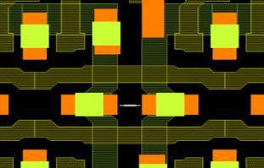
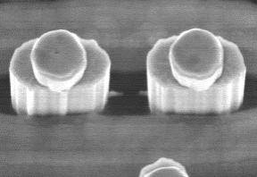
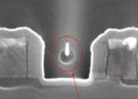
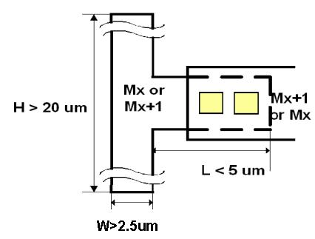
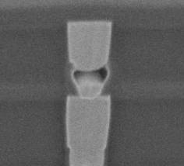

Systematic defects
Spacing dependent tunnel bridge
Area and length dependent via voiding in Cu
R. Madge, et al., IEEE ITC, 2004
Notes:
Defects due to process-design interaction have a systematic nature. Therefore they can have a profound impact on the number of fabricated circuits that can be accepted. The capability to detect (and correct) them is a requirement to continue to follow Moore’s law. Most of the systematic defects are detected during the process development. These defects are detectable with test structures or visual inspection tools. However, some process marginalities will only show up in the topology of real designs. Moreover, these defects are often undetectable by conventional tests – process related defects could only be detected with more advanced test methods such as transition fault testing and low voltage testing. To correct systematic problems, however, one should not only have the capability to detect defects but also to identify them. Therefore, the detection of systematic defects gives new requirements to test suites and can only be achieved with a shift in the position of manufacturing test.

Slide 12
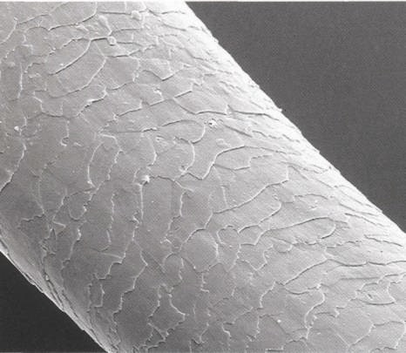
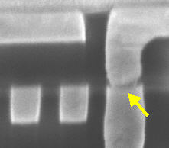
Defect size
Human hair
Diameter 2,000 times smaller

Slide 13
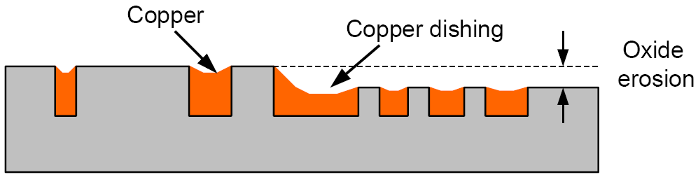
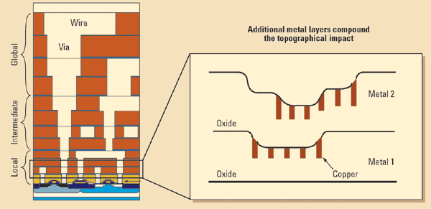
Interconnect variation
CMP dishing & erosion
Multilayer topography
Notes:
In contemporary copper back-end-of-line technology, chemical–mechanical polishing (CMP) is used as the primary technique to planarize the metal surface and define metal layer thickness. Compared to the conventional chemical etching process, CMP has the benefit of high Cu removal rate. However, CMP also introduces undesirable side-effects, including dielectric erosion and metal dishing. The slide illustrates their influence on metal line dimensions after CMP. Both effects originate from the material property differences between dielectrics and metal under chemical and mechanical stresses: since Cu is softer than silicon dioxide, it is more sensitive to the chemical slurry, and, hence, its polishing rate is faster. Consequently, the metal thickness is lower than expected (erosion) and its surface exhibits a cylindrical shape after polishing (dishing). Both erosion and dishing degrade the process quality, cause a significant yield loss, and negatively affect interconnect performance, especially for wide global interconnects. As many experimental evidences point out, the largest contributor to design yield loss is metal to metal shorted lines – 8% for Metal 1 and 6% additional loss for Metal 2. This can occur when normal line width variation for two nearby lines causes them to become too close together, allowing undesired bridging. It can also occur when a particle falls between two lines, causing undesired metal to remain. One remedy for this is to analyze the susceptibility to these modes of failure, and reduce this susceptibility to shorts by separating lines and adjusting the metal interconnect routing to locations that utilize the “white space” found on SoCs. The second highest contributor to yield loss is the contact failure, at 7%. Contacts and vias have a simple task: as long as a good connection between layers is made, the contact or via does its job. However, many subtle effects can lead to failure.

Slide 14
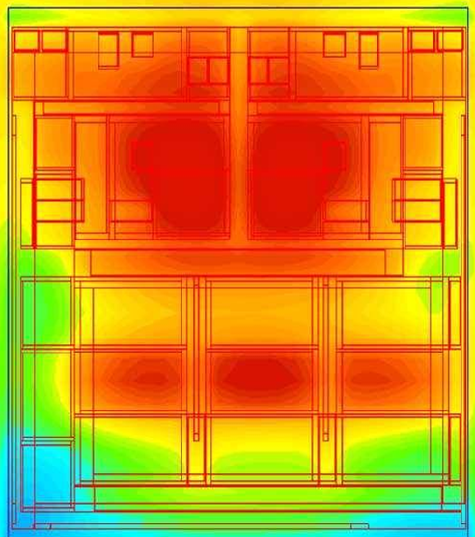
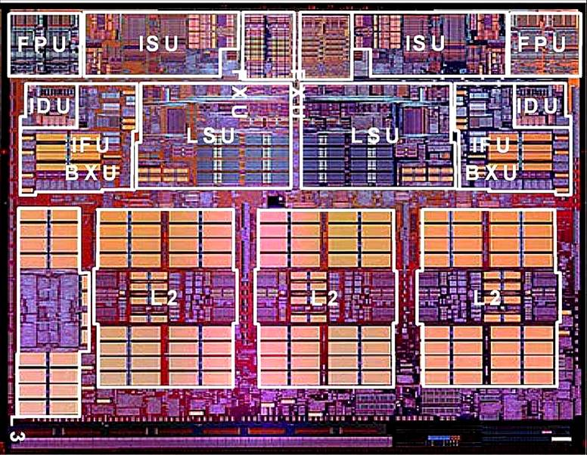
Environmental variation
Temperature profiles vary spatially and with time (switching activity)
deg C
82.0070
80.1173
78.2277
76.3380
74.4483
72.5587
70.6690
68.7793
66.8897
C. Visweswariah, IBM
Notes:
As scaling down of semiconductor technologies continues, thermal issues in integrated circuits become increasingly more pronounced. These problems, especially the strongly localized temperature non-uniformity (hot spot), significantly limit the performance and reliability of VLSI circuits. In addition, the increasing leakage power and its exponential dependence on the temperature require much attention to thermal-aware simulations and optimization. State-of-the-art thermal measurement techniques, such as thermo-reflectance imaging, are very useful in obtaining the IC surface temperature profile. Thermal-aware simulators can predict the IC temperature profile without resorting to actual measurements, and they are very useful in physical chip design processes such as routing and placement. Effective methods for computation of temperature profiles from the power dissipation profiles are important tools for chip designers and test engineers to identify hot spots or meet thermal requirements prior to actual chip fabrication. Typically, the computation of an IC’s temperature profile from its power dissipation profile is performed by grid-based solvers using finite element methods or finite difference methods.

Slide 15
Test objectives
Ensure that chip, board or system have been manufactured properly and will perform all their design functions as defined in specifications
TTL
ECL
CMOS
NMOS
BiCMOS
others
Technology
functional
structural
DC parametric
AC parametric
Kinds of tests
wafer
test sites
chip carrier
package
board
system
Manufacturing level
characterization
production
burn-in
incoming inspection
prevention
Purpose
random logic
memory
gate array
others
Type of device
Notes:
Many integrated circuits are produced in large volume and operate at high speeds. Since their manufacturing yield strongly depends on the silicon area, and their performance is directly related to the delays on critical paths, it is essential that the testing strategy provides a high fault coverage without a significant area overhead and performance degradation. Goals and types of actual tests depend on many factors that include a kind of tested devices (and a specific technology used to fabricate them), a phase of the product life cycle (starting from a die on a wafer and going all the way up to the system level), a basic kind of test patterns (mainly parametric vs. functional), and last but not least – the actual objective of testing: whether this is done for the characterization purposes, during manufacturing testing, or as one of many forms of testing performed in the field.

Slide 16
The most critical problem
Support
Standards
1000 people surveyed at 200 OEM (original equipment manufactures) companies
Analog
System level
Price
Performance
Simulation
Time
CAD tools
Test
ASIC Technology and News, 1990
Notes:
For a long time, testing is recognized as one of the most critical aspects of the entire commercial IC manufacturing process. There are many reasons for this situation. New semiconductor technologies witness increasing high quality demands driven by reliability needs. As circuits grow in size, it becomes more and more expensive to retain high level of test coverage. This is, for example, due to prohibitively large volumes of test data and long test application times. Therefore, despite many crucial factors (shown on the slide) that may impact IC design and manufacturing flows, it is widely agreed that with the increasing complexity of designs, high quality testing remains the key and most important component that enables reliable manufacturing of integrated circuits.

Slide 17
Testing Bermuda triangle
Cost
development
application
Impact
Quality
performance degradation
area overhead
defect level
fault coverage
Notes:
A testing Bermuda triangle consists of three key components affecting IC testing: its cost (in terms of development and application), its impact on designs (with respect to both performance and silicon real estate), and its quality (measured by means of test coverage and characterized by more subtle figures of merit, such as a defect level). A difference between the real Bermuda triangle and this one is that in the real Bermuda triangle ships and airplanes tend to disappear, whereas in this particular triangle, all its components tend to stubbornly stay around and conflict each other. We will discuss all these factors during this lecture and subsequent ones. Traditionally, VLSI test economics strategy tries to balance the cost of the factors to gain maximal profit. We will see various trade-offs one can think of, and how they impact the test realm in various dimensions.

Slide 18
Cost of test
The largest single component of IC cost (25% – 40%)
Automatic test equipment (ATE) – a few millions of $
Highly qualified R&D staff
Time-to-market pressures
more test (e.g. at-speed)
higher coverage
bigger designs
longer runtimes
Test tools must keep pace with design technologies and test methodologies
increased integration and automation
improved performance
Notes:
Clearly, testing is responsible for the quality of VLSI circuits. Testing for quality assurance is approaching 50% of the manufacturing costs for some complex mixed-signal IC’s. Several trade-offs are often necessary to obtain the required quality level at reasonable costs. In principle, the cost of test includes the cost of automatic test equipment (ATE – initial and running costs), the cost of test development (CAD tools, test pattern generation, test programming, etc.), and the cost of design-for-testability (DFT) instrumentation. Most likely, the cost of DFT will dominate test economics equations, as the scan-based design paradigm reduces the cost of test generation, and various built-in self-test (BIST) schemes can lower the cost of ATE. Interestingly, a "reasonable" level of field failure may be a necessary trade-off in exchange for lower IC costs and better time-to-market. At worst, some chips may prove simply untestable at any cost that would place them within their intended market. The most appealing observation is that the test costs represent the largest single component of unit cost (IC total manufacturing expenditures), as a significant portion of this spending (as much as a third on the average) goes to various test-related activities.

Slide 19
Production cost vs. test
$/transistor
10⁻²
10⁻³
10⁻⁴
10⁻⁵
Production cost
10⁻⁶
10⁻⁷
10⁻⁸
Test cost
10⁻⁹
‘82
‘85
‘88
‘91
‘94
‘97
‘00
‘03
‘06
Notes:
The diagram on this slide illustrate the trend in manufacturing versus test cost that have been observed by many silicon-processing facilities. The transistor manufacturing cost (of which the total IC processing cost can be easily anticipated) has steadily been dropping, while the test cost has remained virtually flat or, in some cases, has increased slightly. It clearly indicates that once overlooked cost of test becomes now something of paramount importance. Currently, for many manufactures of complex integrated digital devices, cost of test is in the range of 3% to 30% of the overall manufacturing cost versus fraction of a percent that it once used to be.

Slide 20
The rule of 10
Warranty repair
1000
Cost per fault [$]
600
100
System test
60
10
Board test
6.0
Component test
1
Probe test
0.6
Insert test
0.06
A fault missed at one level could cost as much as 10 times to detect the same fault at the next level
Notes:
The costs associated with detecting faults rise over thousands of times from the time the product is specified to the time the product is released to customers. For example, if a fault is not detected by chip testing, then finding the same fault costs 10 times as much at the PCB level as at the chip level. Similarly, if a board fault is not caught by PCB testing, then finding the very same fault costs 10 times as much at the system level as at the board level. There are claims that this rule should be renamed today the rule of 20 because of contemporary chips, boards and systems enormous complexity. This is why the most effective way to prevent costly prototyping turns is to consider testing issues as early in the design cycle as possible. Tremendous practical importance of this problem generated an immense amount of research in an attempt to develop testing schemes of the ultimate quality.

Slide 21

Manufacturing and testing
Final test
Assembly
Yield
Wafer sort
Defect level
Defect-free
Electrical test
Defect-free
Fabrication
Testing
Escapes
Defective
Yield loss
Rejects
Yield – the percentage of good parts among all parts fabricated
Defect level – the proportion of faulty parts in a batch of chips passing final test
Notes:
Some percentage of the manufactured circuits is expected to be faulty due to manufacturing imperfections. The percentage of acceptable devices among all devices that have been fabricated is known as yield. Interestingly, not all defective devices will be actually rejected. The quality of testing is often defined as the number of faulty chips that pass the test for one million chips declared as good. This figure of merit is referred to as a defect level. Many microelectronics companies have already set their testing quality goals to less than 100 dpm (defects per million), and there is intensive ongoing research to lower this number to less than 10 dpm as targeted in the Six-sigma project pioneered by Motorola. On the other hand, there might be defect-free chips that will be discarded anyway (as faulty ones) due to other imperfections of a testing procedure itself (for example, a test may create harsh conditions forcing a circuit to malfunction). These chips contribute to another figure of merit known as a yield loss.

Slide 22
Six-sigma
Mean shifted by -1.5σ
Mean shifted by 1.5σ
1.5σ
1.5σ
Upper spec limit
Lower spec limit
-6σ
0
6σ
If products can be designed to accept ±6σ and the process mean can be controlled so it shifts no more than ±1.5σ from the distribution center, the defective rate will be no more than 3.4 parts per million
Notes:
Six-sigma originated as a set of practices designed to improve manufacturing processes and eliminate defects, but its application was subsequently extended to other types of processes. In Six-sigma, a defect is defined as any process whose output does not meet customer specifications, or that could lead to creating such a situation. It was originally developed by Motorola in 1986 when the company discovered a link between increases in quality and decreases in costs of production. The term “Six-sigma process" comes from the notion that if there are six standard deviations between the process mean and the nearest specification limit, as shown on the slide, virtually no items will fail to meet specifications. As can be seen, the normal distribution underlies the statistical assumptions of the Six-sigma model.
Typically, processes do not perform as well in the long term as they do in the short term. As a result, the number of “sigmas” that will fit between the process mean and the nearest specification limit may drop over time. To account for this increase in process variation over time, an empirical 1.5 sigma shift is introduced into the calculation. Thus, a process that fits 6 sigma between the process mean and the nearest specification limit in a short-term will fit only 4.5 sigma in the long term – either because the process mean will move over time, or because the long-term standard deviation of the process will be greater than that observed in the short term, or both. Hence the widely accepted definition of a Six-sigma process is a process that produces 3.4 defective parts per million. This is based on the fact that a process that is normally distributed will have 3.4 parts per million beyond a point that is 4.5 standard deviations above or below the mean.

Slide 23
Six-sigma and DPM
Defects per million (DPM)
< 500 acceptable
< 100 high quality
< 3.4 zero defects
The process mean shifts less than ±1.5σ (Motorola)
Limit | Good [%] | DPM | Good [%] | DPM
±1σ | 68.27 | 317300.000 | 30.23 | 697700.0
±2σ | 95.45 | 45500.000 | 69.13 | 308700.0
±3σ | 99.73 | 2700.000 | 93.32 | 66810.0
±4σ | 99.9937 | 63.000 | 99.379 | 6210.0
±5σ | 99.999943 | 0.570 | 99.9767 | 233.0
±6σ | 99.9999998 | 0.002 | 99.99966 | 3.4
Notes:
To achieve Six-sigma quality, the product must first be designed so that the manufacturing processes are capable of yielding 99.99966% in the product. For example, assume the electrical design of an amplifier requires that the gain be greater than 12 dB. Both the manufacturing processes and the design must be capable of yielding 999,996.6 out of one million amplifiers that meet their requirements and only 3.4 out of the million amplifiers that do not meet their requirements, i.e., gain less than 12 dB. So, Six-sigma design process translates into perfecting the design process to ensure products that are at least 99.99966% defect free.

Slide 24
At-speed test – effect on DPM
LSI¹ experiments
at .18μm 1% defects were speed-related
at .13μm 2% defects were speed-related
30-70% DPM reduction w/at-speed test
Intel² claims 1-5% of defects are at-speed failures
1) B. Benware et al., IEEE VTS 2003
2) K.S. Kim, S. Mitra, IEEE Design & Test, 2003
Notes:
Companies that have already experienced problems with growing DPM rates are turning to at-speed testing (more on this peculiar form of testing can be found in chapters devoted to fault models and design for testability). For example, LSI found that the number of speed related defects doubled as they moved from .18 micron to 130nm. When they employed at-speed testing, they saw an immediate DPM reduction (even on their .18 micron designs) of 33% - 70%. Intel also published a paper claiming that 1-5% of the defects found in some of their designs were the result of at-speed failures. Testing for these types of defects had a positive impact on DPM reduction.

Slide 25
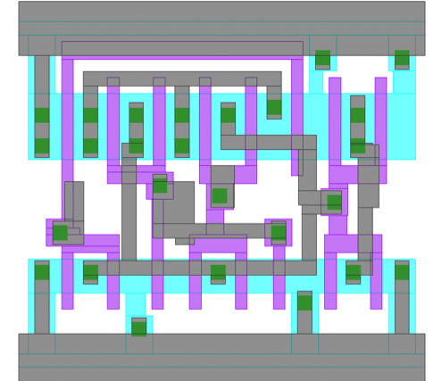

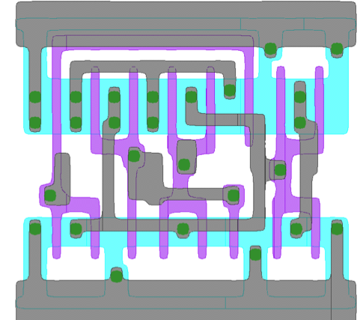
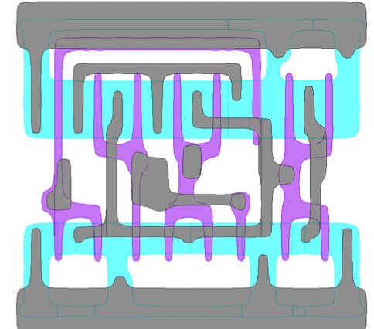
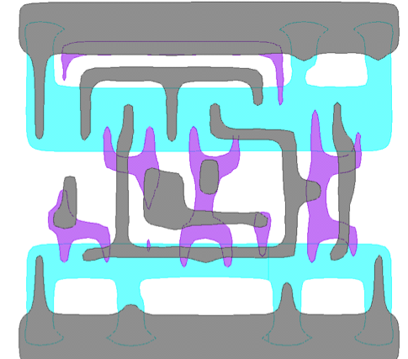
Yield crisis
Target
Above lithography wavelength
350nm
250nm
Sub-wavelength
130nm
90nm
Historical initial yield
M. Rencher, G. Allan, EE Times
Notes:
In today’s nanometer technologies, design sensitivity to physical elements continues to increase. Aside from the traditional physical defects, lithography, process variations, or design methodologies may also contribute to a poor yield. When IC lithography prints features larger than a wavelength, imaging distortions can be generally ignored. With sub-wavelength features, distortions dominate the imaging process. As a process is operating near the failure mode, small changes in the mask layout can result in large changes on the corresponding wafer. Although predictable, this can indicate when control should be applied and when it can be relaxed. Optical proximity effects, caused by diffraction as lines move closer together, also alter the predicted line widths. To correct for these, OPC (optical process correction) software alters the IC layouts for each critical layer of lithography, tailoring the pattern on the mask to the exact lithography conditions. To do this, advanced OPC programs have a process modeling and calibration routine that systematically measures the distortions, and produces a succinct set of parameters that can be generically called a process behavior model. As a result, one can observe a continued reduction in initial product yields, increased yield learning times and increasing significance of the physical effects on yield.

Slide 26
Quality requirements
Escapes
1 – p
Faults detected
Shipment
p
Yield
1 – Yield
p – probability of detecting a fault
Notes:
This is a basic model that can be used to illustrate and derive a simple relationship between defect level, yield and quality of test. Let us assume that the total area occupied by rectangles shown on the slide represents the amount of ICs that have been manufactured. This area can be conveniently partitioned into three disjoint sections. The first (white) one, in terms of its area, is proportional to the number of fault-free devices (here represented by yield). The grey and red rectangles correspond jointly to the amount of faulty circuits. However, the grey area is proportional to chips where faults were detected (and thus its area depends on p – the probability of detecting a fault, here also representing the quality of a test procedure), whereas the red part represents test escapes – faulty devices that have been accepted due to inability of deployed test procedures to detect any fault. Clearly, chips represented by both the white and red rectangles will be shipped to customers.

Slide 27
Defect level formula
The number of escapes is proportional to (1 – p)(1 – Y)
Escapes
1 - p
1 - Y
Defect level
(1 – p)(1 – Y)
DL =
Y + (1 – p)(1 – Y)
p + 1 – p = 1
p – probability of detecting a fault
Y
Notes:
As can be seen, the defect level is represented in our model by a ratio of areas corresponding to the red rectangle and jointly the red and white rectangles, respectively. Clearly, the number of escapes is proportional to (1 – p)(1 – Y), where Y is yield, and p is equal to the probability of detecting a fault. On the other hand, the white area can be easily determined as Y (1 – p + p) = Y. Hence, the final defect level ratio can be computed as shown on the slide.

Slide 28
Defect level vs. yield
(1 - p)(1 - Y)
Yield = 0.9
Yield = 0.1
p
Notes:
This diagram illustrates a relationship between the quality of testing and the defect level for a varying value of yield. These curves have been obtained by plotting a formula derived on the previous slides. As can be easily observed, with the increasing value of p (recall that this is the probability of detecting a fault, and it somehow reflects the test quality) the defect level decreases (this is why the quest for high test quality is so important). As one may expect, the defect level goes down even faster with the increasing value of yield.

Slide 29
Characterization testing
To verify that the design is correct and to determine the device characteristics
To obtain the most accurate data by taking measurements of AC and DC characteristics
Test time is unimportant
The characterization data used to set the final specification
Done to a lesser extent throughout the device life
Notes:
A few next slides introduce different forms of IC testing. The characterization testing is performed on a new design before it is sent to production. The purpose is to verify that the design is correct and it will meet all specifications. Functional tests are typically run and comprehensive AC and DC measurements are made. Probing of internal nodes of the chip, not done in production testing, may also be required during characterization. Use of special tools such as scanning electron microscopes and electron beam testers, as well as techniques such as expert systems can be helpful. A characterization test determines the exact limits of device operating values. Generally, tests are performed for the worst case as it is easier to evaluate than average cases, and devices passing this test will work for any other conditions. Consequently, functional tests are applied repeatedly while measuring various DC and AC parameters for varying different variables such as supply voltage. Less comprehensive characterization testing is often continued throughout the production life of the device for possible improvements in the design and the process yield. In particular, characterization testing can be carried out on chips rejected during production tests or in the field.

Slide 30
Production testing
To ensure that the device meets its specification and functions correctly while at the same time minimizing test time for maximum cost effectiveness
Production test time is usually 100 times shorter than characterization test time and takes less than a second
Many specifications can be applied at the same time
Notes:
Every fabricated chip becomes the subject of production tests as a circuit-under-test (CUT) of a device-under-test (DUT). These tests are less comprehensive that characterization tests yet they must enforce the quality requirements by determining whether the device meets its specifications. The test patterns may not cover all possible functions but must have a high fault coverage of modeled failures. Since every chip is tested, the main driver of production testing is its cost, including test application time that should be minimized. Production tests are typically short but verify all relevant specifications of the device (usually fault diagnosis is not performed at that time).

Slide 31
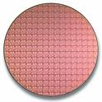
Wafer test
Done to avoid expensive packaging of faulty chips
Refers to testing of special sites on the wafer which consist of a few transistors characterizing technology parameters:
contact resistance
diffusion sheet resistance
metal field threshold
poly field threshold
poly sheet resistance
Notes:
Wafer testing is a step performed during device fabrication, and before a wafer is sent to die preparation. All individual circuits that are present on the wafer are tested by means of so called test sites. They occur on the wafer and hold test structures and circuits such as capacitors, doped regions of silicon, transistors, and other simple devices. These are electrically tested during various phases of the manufacturing process. The test is conducted with an electronic tester that presses tiny probes against the chip. The machine marks each bad chip with a drop of dye. Currently, electronic dye marking is possible if wafer test data is logged into a central computer database and chips are "binned" (i.e. sorted into virtual bins) according to predetermined test limits. The resulting binning data can be graphed, or logged, on a wafer map to trace manufacturing defects and mark bad chips. This map can be also used during wafer assembly and packaging. If the number of dies — the integrated circuits that will eventually become chips — etched on a wafer exceeds a failure threshold (i.e., too many failed dies on one wafer), the wafer is scrapped rather than investing in further processing.

Slide 32
Burn-in testing
To ensure that the device will function correctly for a specified number of years
Based on correlations made between life span at room temperature and life span at elevated temperature
Correlation charts for each technology
It has both characterization and production phases
Characterization requires in-depth statistical analysis
Notes:
Burn-in testing is widely used as an aid in producing failure-free electronic components. It offers an effective method of reliability screening at the component level. By testing individual elements under constant temperature stress, electrical stress, temperature cycling stress, or a combined thermal-electrical stress, burn-in testing can identify discrete faults that may be harder to perceive at the assembly, module, or system level. The aim of the burn-in testing is to ensure that the product as a whole performs properly in changing conditions according to set targets while keeping its performance value. In particular, this form of testing is expected to guarantee that a circuit under test will function flawlessly even at high operating temperatures. One can carry out tests in changing temperatures and extreme conditions that are rare in actual use. This improves the reliability of a device. The testing process is automated, and thus the system saves all information related to testing. The information can then be utilized within quality control as well as to ensure testing traceability. The burn-in test is often combined with functional testing.

Slide 33
Bathtub curve
Number of failures
infant mortality
product life
wear out
…
time
For every 10°C rise in temperature, the rate of degradation doubles
Normal infant mortality time = 5000h for T = 50°C
If T = 120°C then after 5000/128 = 39h we should weed out most of infant mortality failures
Notes:
The bathtub curve is used to describe a particular form of the hazard function comprising three parts:
a decreasing failure rate (early failures),
a constant failure rate, known as random failures, and
an increasing failure rate (wear-out failures).
The bathtub curve is generated by mapping the rate of early "infant mortality" failures when first introduced, the rate of random failures with constant failure rate during its "useful life", and finally the rate of "wear out" failures as the product exceeds its design lifetime. In the early life of a product adhering to the bathtub curve, the failure rate is high but rapidly decreasing as defective products are identified and discarded, and early sources of potential failure such as handling and installation errors are overcome. In the mid-life of a product – generally, once it reaches consumers – the failure rate is low and constant. In the late life of the product, the failure rate increases, as age and wear take their toll on the product. Many consumer products, such as microprocessors, strongly reflect the bathtub curve. The burn-in testing can accelerate the process of IC aging corresponding to the infant mortality period. As shown on the slide, every 10°C rise in temperature doubles the rate of degradation. Hence, after a reasonable time of burn-in test, one can identify a significant majority of faulty devices, which otherwise would fail later in its product life-time.

Slide 34
Board level testing
Not only to detect a faulty component or interconnect, but also to locate it and repair it
Probability that a board containing N components is good
P = (1 – p)
N
N
p – the probability of having a defective component
p | 0.01 | 0.01 | 0.01 | 0.001 | 0.001 | 0.001
N | 10 | 100 | 1000 | 10 | 100 | 1000
P | 0.9 | 0.36 | 0.00001 | 0.99 | 0.9 | 0.36
N = 1000, P = 0.999 ⇒ p = 0.00001
Notes:
The primary objective of testing at the board level is not only to detect faulty components or interconnects that the board is housing, but also to locate and repair them. Originally, dual-in line (DIP) packages dominated IC packaging, and thus every board signal was visible on the bottom of the board, and the pins were spaced on 100 mil (tenth-inch) centers. Relatively simple test tasks were then complicated by a surface-mount technology (SMT) with flat-pack chip packages because of a need to reduce inductance in the PCB by reducing the package height above the ground plane. SMT led to further miniaturization and a cost reduction. In particular, SMT technology features reduced spacing between PCB wires and no through-hole pin targets with solder bumps for nails to hit. Many signals are now simply unavailable for in-circuit testing. These developments resulted in the need to create a new PCB test delivery system to the components. Finally, the IEEE 1149.1 standard has fulfilled these requirements – further details can be found in the section devoted to design-for-testability schemes.
The slide illustrates how reliable components must be in order to guarantee very low probabilities of having a faulty PCB. Even, if a defect level is equal to 0.001, a board that houses as many as 1000 chips will function properly with the probability of 0.36, only. In other words, in order to reach a level of truly reliable performance (the corresponding probability being equal to 0.999), one needs a very high quality test scenario that delivers accepted chips with the targeted defect level below 0.00001.

Slide 35
Incoming inspection
Usually vendors may not test all of the components that they ship (only random samples); components may be also exposed to environmental hazards or physical abuse during shipment
The goal in system manufacturing is to ensure that all components used in the system function properly and according to specification
More thorough test than production test
Finding a faulty component at the board level or at the system level is much more expensive (see the rule of 10)
Notes:
The objective of incoming inspection (also known as acceptance testing) is to verify and document that all applicable specifications and requirements pertaining to purchased parts and customer product specifications and requirements are satisfied by outside suppliers. The incoming inspection will also verify and document the condition of customer supplied materials as received by system manufactures. These operations are executed before integrating the supplied devices into the system. Depending on the context, this form of testing can be either similar to production testing, more comprehensive, or even tuned to specific system applications. Also, the incoming inspection may be done for a random sample with the sample size depending on the device quality and the system requirements. Clearly, the key objective of the acceptance testing is to avoid placing a defective device in a system assembly where the subsequent cost of fault diagnosis may by far exceed the cost of incoming inspection.

Slide 36
Types of tests
Functional test – verifies the device switching function
Structural test – uses structural data and fault models
DC parametric test – electrical characteristics determined based on Ohm’s law
current consumption
output drive capability
input leakage current
ability to operate at the proper voltage levels
AC parametric test concerned with timing relationships
propagation delay time
setup, hold, rise, fall, access and refresh times
minimum clock width, speed
Notes:
In general, a digital circuit can be subjected to three types of tests: (1) functional tests, (2) structural test, and (3) parametric tests. Functional tests consist of input patterns (and the corresponding test responses) that check the proper operation of a verified device by testing its internal nodes. In other words, functional test might be considered as a test that “mimics final operation”. Typically, they cover a high percentage of modeled faults. Consider a simple combinational circuit. A complete functional test would check each entry of its truth table. However, this approach becomes quickly impractical for most of real designs with several hundred inputs (still, it might be necessary to run similar and very exhaustive verification procedures – this issue goes beyond the scope of this course). Since the purpose of production test is to discover any faults caused by manufacturing imperfections (while assuming that the design itself is correct), a much more efficient technique is to use structural tests that depend on the specific structure of the circuit (by testing the components instead of operation) and work, in an algorithmic fashion, with fault models (see the chapter on fault models used in the test realm). DC parametric tests include procedures targeting shorts, opens, maximum current, leakage current, output drive current, or threshold levels. Finally, AC parametric tests, concerned with timing relationship, examine propagation delays, setup, hold, rise, fall, access and refresh times, as well as characteristics of a system clock such as its minimum width, speed, and others.

Slide 37
Why not functional tests?
Functional tests are developed to mimic functional behavior of the circuit
Disadvantages
required detailed circuit knowledge
expensive development and troubleshooting
difficult to create high coverage patterns
complicated failure diagnosis
often required high performance testers
large inter-dependent test sets
Notes:
Functional testing attempts to verify that a device under test functions according to its specification. Therefore, a user does not need to know the detailed structure of a circuit; only the functions of different modules and their interactions with each other are of interest. This makes functional testing very attractive. Historically, many companies have tested their products with manually generated functional tests that were applied at speed using functional, high performance testers. The advantages of functional testing include a high correlation to customer experience, relatively short test application time, and accurate measurement of test speed. Furthermore, it avoids over-testing since it is performed in a functional mode.
However, preparing functional tests requires both architectural design knowledge and testing expertise, and this process cannot be readily automated. The major problems arise from the fact that it is almost impossible to derive a test sequence which takes into account all possible ways a system can fail. In fact, any functional test must take into account a near-infinite number of failure modes in order to achieve a satisfactory fault coverage. Since this is unrealistic in practice, a general functional fault model is needed for the verification of the correct operation of complex designs. The fundamental issue is then how to map physical failures into faults at the functional level. This is an extremely complicated task because of a large number of system functions. Unless suitable fault models for digital circuits can be derived, the exact fault coverage achieved by a functional testing cannot be determined.

Slide 38
Why structural tests?
To detect manufacturing defects in the device
Use fault models to enable test generation
correlate to defects
proven in industry
predictable results
provide high coverage tests quickly
Can be automated and are repeatable
Notes:
Structural tests are used in production test of most VLSI digital circuits because these tests are easier to create with the help of many automated tools, fault grade (e.g., through fault simulation), and apply. They also facilitate simpler diagnosis of faults than functional tests. The primary objective of structural tests is to detect structures that deviate from a declared defect-free design, which is a much narrower objective than for functional (specification-based) tests. However, structural tests must be well-correlated to physical defects – we will discuss test schemes whose wide-spread use in industry indicates that they actually meet this requirement for contemporary digital designs.

Slide 39
Fault coverage
There is no simple way to measure the test set quality
Fault coverage – percentage of faults detected used to measure the efficiency of a test set
DL = 1 – Y^{(1 – F)}
DL – defect level
F – fault coverage
Y - yield
The model assumes uniform independent defect distribution, and it is valid for high yield and fault coverage
T.W. Williams, N.C. Brown, IEEE Transactions on Computers, 1981
Notes:
Fault coverage of a test set applied to a circuit-under-test is generally defined as the number of particular faults detected (by this set) divided by the number of potential faults of the same type. Typically, for digital circuits, the number refers to stuck-at equivalent faults (see the next chapter), and for analog, the number refers to shorts and opens. Fault coverage is often used to measure the test set quality. Let us assume that a given chip has a certain number of stuck-at-faults, which can be modeled with the standard stuck-at-fault assumption. Furthermore, assume that the probability of a fault occurring is independent of whether any other fault has occurred or not, and that all faults are equally likely with the same probability. With these assumptions, Williams and Brown have proved that defect level is exponentially related to fault coverage by deriving a formula expressing defect level in terms of yield and fault coverage, as shown on the slide. The same formula can also be used to estimate the defect level at the board, if the modules on the board are equally likely to have a fault and are independent with no manufacturing defects induced.

Slide 40
General test scheme
Physical failure analysis
Fault modelling
Test generation
Fault simulation
Test application
Accepted
Faulty
Yield loss
Fault-free
Faulty
Notes:
To conclude, the slide illustrates a general test flow. It begins with a physical failure analysis and fault modeling. Defects manifest themselves in a variety of ways. Ideally, it would be desirable to model defects directly and independently from the methods used to detect them, but realistically defective behavior must be extrapolated and simplified into fault models. Given a fault model, one can generate test patterns, for example in a deterministic manner by using one of the available test generation tools, or by using a source of pseudorandom test vectors. Typically, a test pattern generator works in conjunction with a fault simulator, which evaluates tests and determine their coverage. The resultant test set can be then applied to a circuit-under-test. As discussed earlier, even if a circuit is accepted, there is still non-zero probability that one may deal with a test escape – a faulty device whose defects remain undetected due to an inadequate test procedure. Clearly, chips declared as faulty are discarded, though their population may contain devices which are actually fault-free (contributing to a yield loss), but have not been recognized as such, again because of problems with a test application process.

